Slide 1
BANK CRM ANALYSIS
by Arnav Bangaria

Slide 2
PROBLEM STATEMENT
The bank aims to reduce customer churn, improve service delivery, and enhance customer satisfaction.

Slide 3
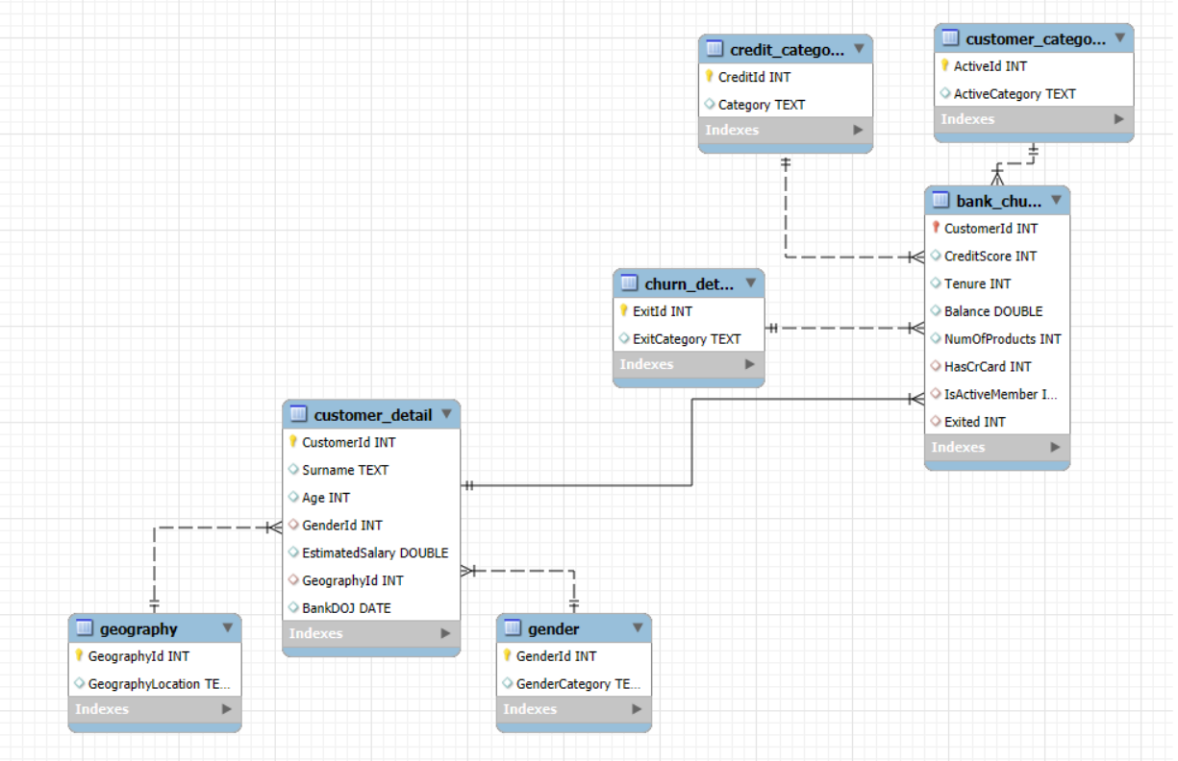
DATA OVERVIEW
There are a total of 7 tables in the dataset, which are renamed to make executions better:
ActiveCustomer ⇒ customer_category
Bank_Churn ⇒ bank_churn
CreditCard ⇒ credit_category
CustomerInfo ⇒ customer_detail
ExitCustomer ⇒ churn_detail
Gender ⇒ gender
Geography ⇒ geography

Slide 4
DATA OVERVIEW
S.No | Table Name | No. of Attributes | Categorical / Continuous Count
1 | customer_detail | 6 | 3 Categorical, 2 Continuous, 1 Date
2 | geography | 2 | 2 Categorical
3 | gender | 2 | 2 Categorical
4 | credit_category | 2 | 2 Categorical
5 | customer_category | 2 | 2 Categorical
6 | churn_detail | 2 | 2 Categorical
7 | bank_churn | 8 | 5 Categorical, 3 Continuous

Slide 5
METHODOLOGY
DATA CLEANING AND STRUCTURING
Using Excel to remove duplicity or inconsistency within data and formatting all the columns into the right data format to make it seamless to import or connect with the Power BI Desktop
Using SQL to build relationships, understand data, and derive some meaningful insights that will help in decision-making
Using Power BI to generate reports and a KPIs dashboard through models, visualizations, measures, and slicers to assist strategy building for the bank
DATA MANIPULATION
Removing inconsistencies and duplicates from the data, table by table, to maintain consistency
DATA ANALYSIS
Customer Behaviour Analysis to map how our customer behaves and what the frictions and accelerators are
Demographical Analysis to segregate groups that have low performance and high churn
Time series Analysis to detect any joining or leaving pattern of risky customers
VISUALIZATIONS
Developing a KPI Dashboard to summarize individual analysis findings

Slide 6
ANALYSIS PHASE

Slide 7
Customer Behaviour Analysis
There are 10000 total customers, out of which 51.51% customers are active customers. About 70.55% of total customers have a credit card. One out of every five customers churned.

Slide 8
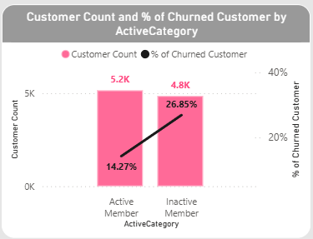
Customer Behaviour Analysis
Customer Churn is approximately 10% higher among inactive members compared to active bank members. Keeping in mind that approx. half of the members are active.

Slide 9
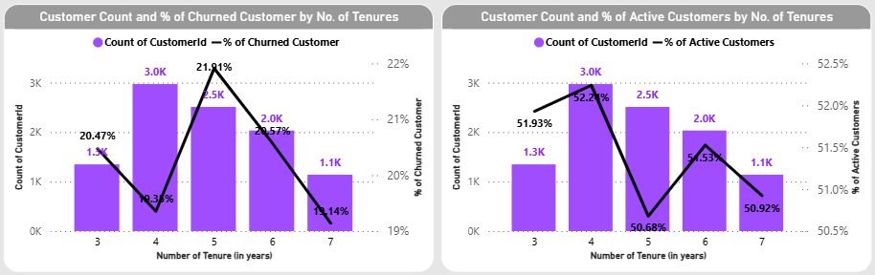
Customer Behaviour Analysis
Considering the customer having a tenure >4 years as long-term and the rest as new. We can derive that customers who have just become long-term, i.e, having tenure of 5 years, have a higher churn rate of 21.91%, and the lowest active members are about 50.68% followed by new customers having a tenure of 6 years.

Slide 10
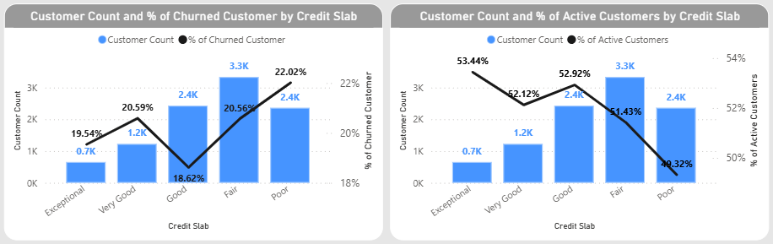
Customer Behaviour Analysis
Customers with a Poor credit rating have the highest churn rate and lowest activeness. While the highest activeness is seen in customers with Exceptional rating, and the lowest churn rate is in Good ratings, combined with the second-highest active customers.

Slide 11
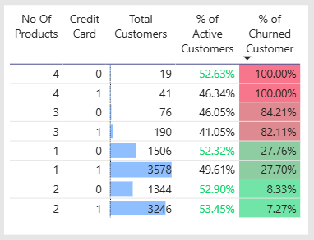
Customer Behaviour Analysis
There is a 100% churn rate among customers who have 4 products. About three out of every four customers leave if they have 3 products. At the same time, the retention rate is highest in customers having 2 products. Non-credit card holders have a higher churn rate than credit card holders.

Slide 12
Customer Behaviour Analysis
ABNORMALITIES BEHAVIORAL INSIGHTS
Filter Category | Insights
Credit Card Holder or Non-Credit Card Holder | In terms of credit card ratings, non-credit card holder shows an anomaly, i.e., there is a high churn rate in the Exceptional credit rating, nearly the same as the Poor credit rating, about 23.15% churn In terms of tenure, new customers have an increased churn in non-credit card holder customers
Age Group: 18-30, 31-50 and 50+ | In terms of tenure and credit card ratings, the 18-30 age group doesn’t show any deviations In the age group 31-50, there is an anomaly considering the Active and Inactive customers. Here, the trend reverses, and there is 10% more churn in Active members In the age group 50+, there exists the highest churn rate, and even customers with Excellent and Very Good credit ratings have churned

Slide 13
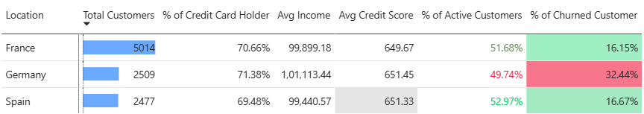
Demographical Analysis
More than 50% of customers reside in France. Spain has the highest % of active customers at 52.97%. Germany has the highest churn rate at 32.44% with the lowest % of active customers at 49.74%.

Slide 14
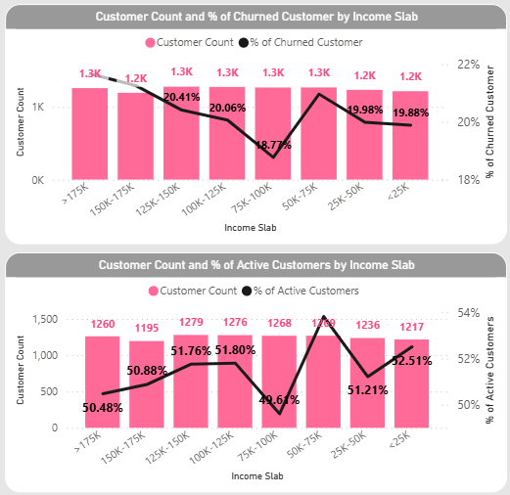
Demographical Analysis
Higher income groups have a higher churn rate compared to lower income groups. There exists a declining churn rate trend as we move down to the lower income group, except one income group, 50K-70K, which has high churn and the highest active customer.

Slide 15
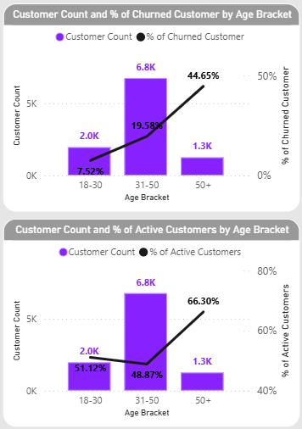
Demographical Analysis
Age group 50+ has the highest churn rate as well as the highest active customers. Age group 18-30 has the lowest churn rate. While age group 31-50 holds about 68% of total customers.

Slide 16
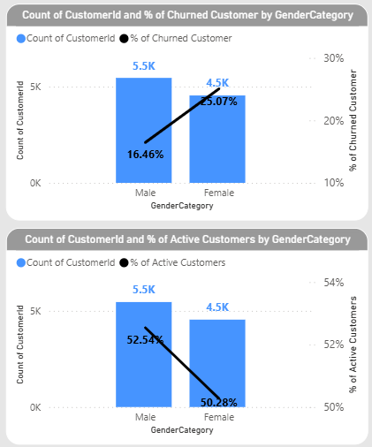
Demographical Analysis
There are approximately. 10% more Male customers as compared to Female customers. But churn rate is higher in Female customers as compared to Male customers by 10%. Females have a higher average income in comparison to Males.

Slide 17
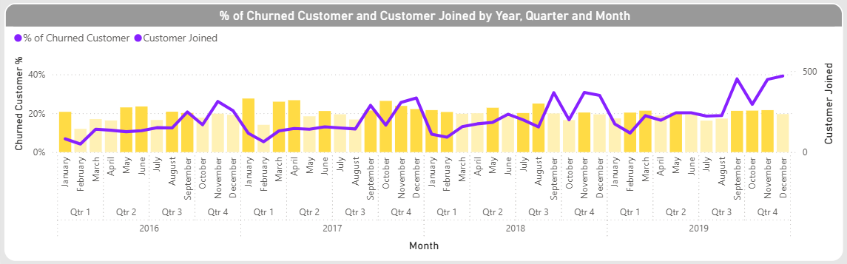
Lifetime Value Analysis
There is a growing trend of customers joining. From the middle of Quarter 3 to the end of Quarter 4, there is a steep increase in the number of customers joining. 2017 is the year that witnessed a large number of churned people in starting as well as end of year. There is a high churn in the month of January across all years. Highlighted yellow bars indicate churn greater than the average churn of 20.37%

Slide 18
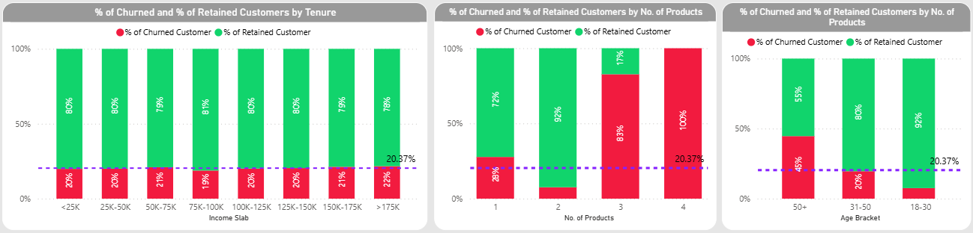
Lifetime Value Analysis
The following are the comparisons of major factors against the average churn rate. Customers having 2 products have the lowest churn rate. Age group 18-30 has the lowest churn rate, and Income groups >150K and 50K-75K have a slightly higher churn rate.

Slide 19
FINDING PHASE

Slide 20
Drivers of Churn Rate
CHURN RATE
Number of Products
Risky – 4 products
Safe – 2 products
Age Group
Risky – Senior Citizens (50+)
Safe – Young Adults (18-30)
Location
Risky – Germany
Safe – France
User Activity
Risky – Inactive
Safe – Active
Gender
Risky – Female
Safe – Male

Slide 21





Strategic Suggestions
Handling the No. of Products parameter
Focusing less on customers having 3 or 4 products. Focusing more on customers having 1 product and then motivating them to acquire another product, most preferably a credit card (due to comparatively less churn)
Handling Age Group parameter
Giving higher rewards to young adults (18-30) and lowering attention on senior citizens (50+). Improving services for active members in the age group 31-50 to reduce churn
Handling Location parameter
Expanding into the markets of Spain due to high active customers and low churn. Maintaining health balance in the market of France. Understanding and making calculated decisions in the German market.
Handling User Activity parameter
Inactive customers without a considerable credit rating should be given higher rewards. Active customers having considerable credit ratings should be given higher rewards and additional rewards for credit card usage.
Handling the Gender parameter
Since Females have a higher churn rate and lower activeness than Males, we should find the bottlenecks of such behaviour and make policies and reward systems that a proper balance can be established.

Slide 22
CONCLUSION

Slide 23
Goal | Improvement Area | Recommendations
Reduce Churn Rate | Number of Products | Directing the customer to have a maximum of two products. Introduce credit cards to customers who have one product and do not use credit cards.
 | Location | Acquiring more customers in Spain. Making calculated decisions in Germany,
 | Age Group | Building reward systems to provide incentives to Senior Citizens (31-50) and growing customer base in Young Adults (18-30)
Improve Service Delivery | Age Group | Tailoring strategies and services to address Middle Aged Adults (31-50).
 | Credit Category | Offering lucrative credit card services and higher benefits to non-credit card holders
 | Gender | Understanding the pain points of female customer who have higher average salary than male and low activity to increase their participation
Customer Satisfaction | Active Members | Active members should be handled carefully, and non-active members should be surveyed for inactivity.

Slide 24
THANK YOU

